Slide 1





Sound Surfer
A new kind of wearable gaming experience
To get you moving…
… and maybe even grooving…
A new from of wearable gaming…

Slide 2
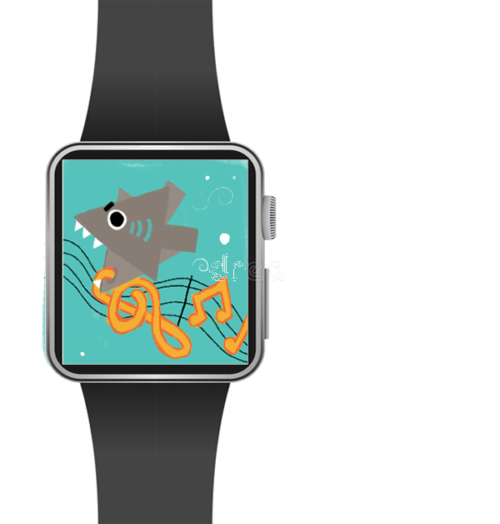

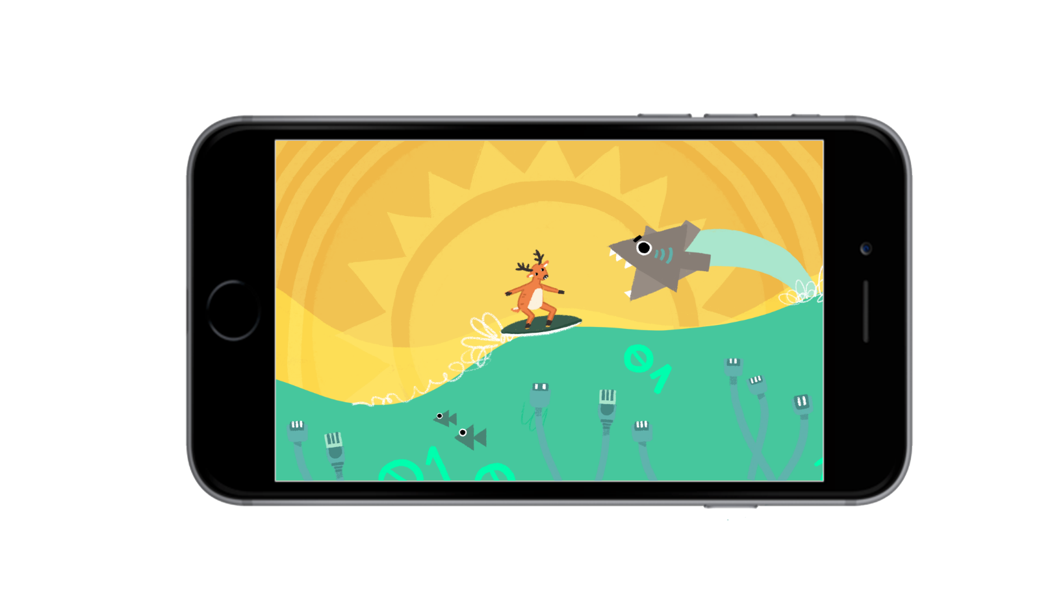
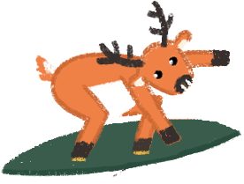

Concept
To encourage players to make physical movements while interacting with a virtual game world, that is simulated by their musical input.

Slide 3

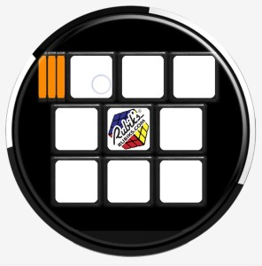

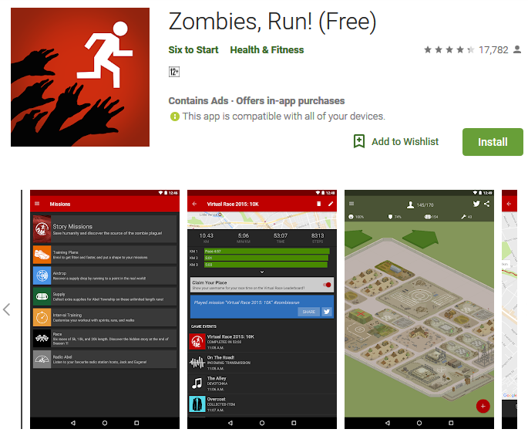
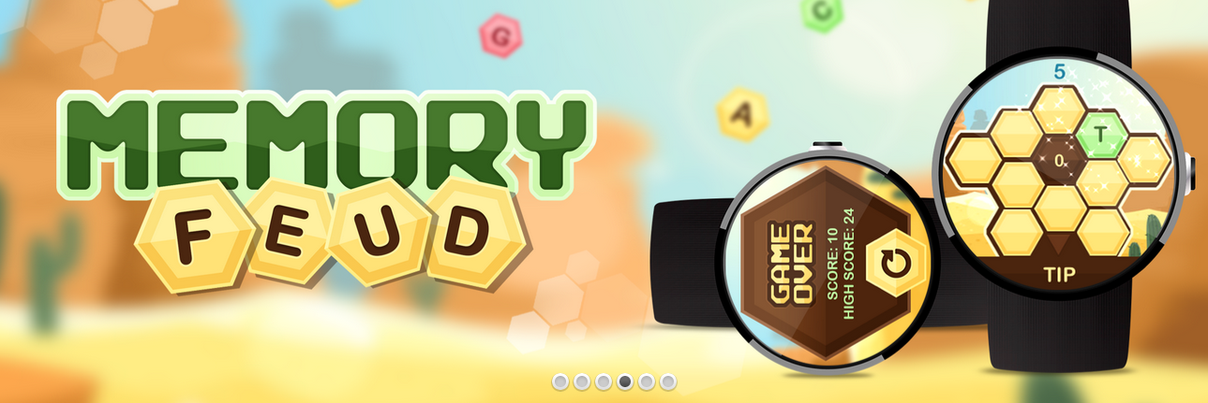
Research and Marketability
- Wearable gaming
- Physical exertion games
- Sound based games

Slide 4
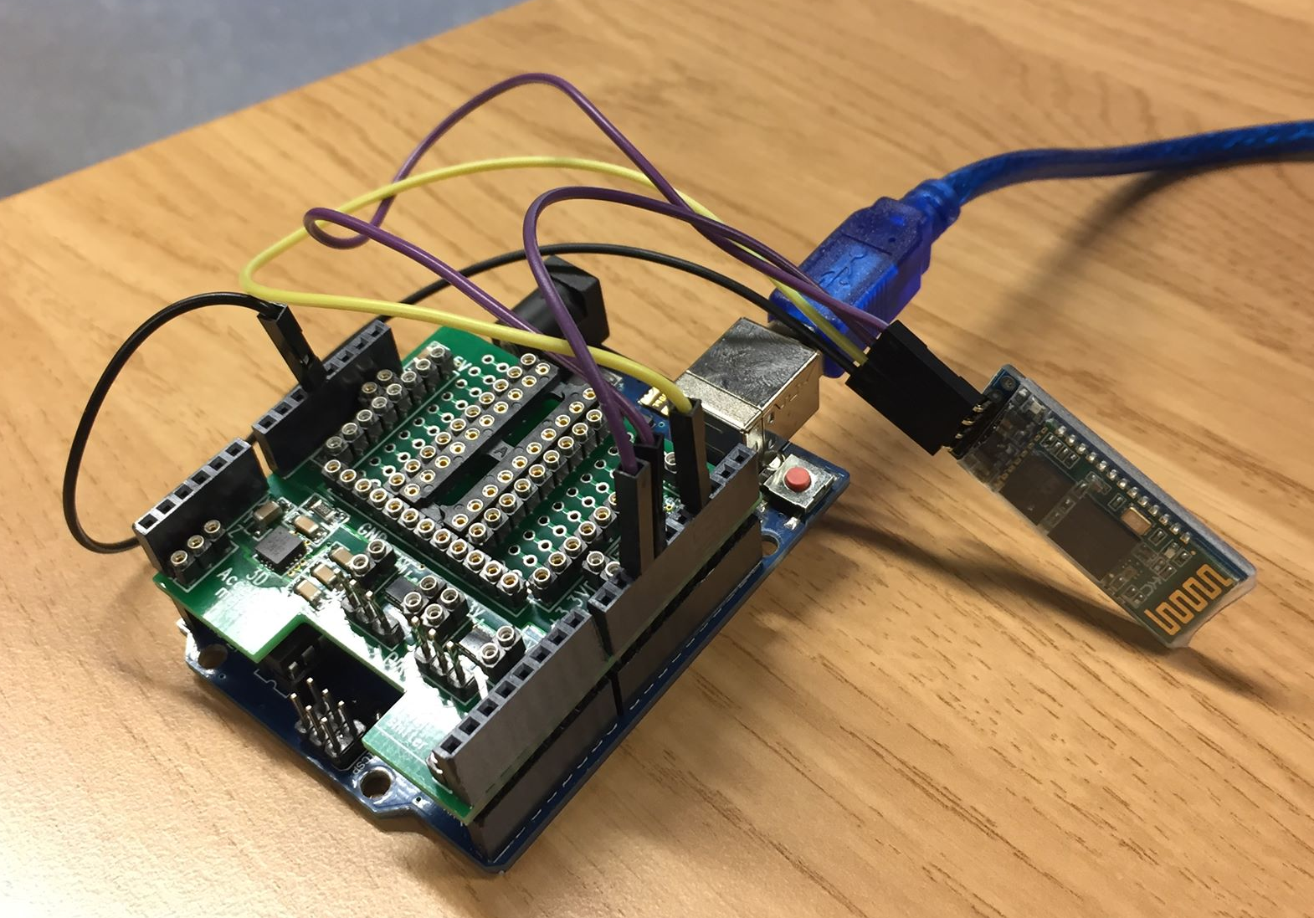
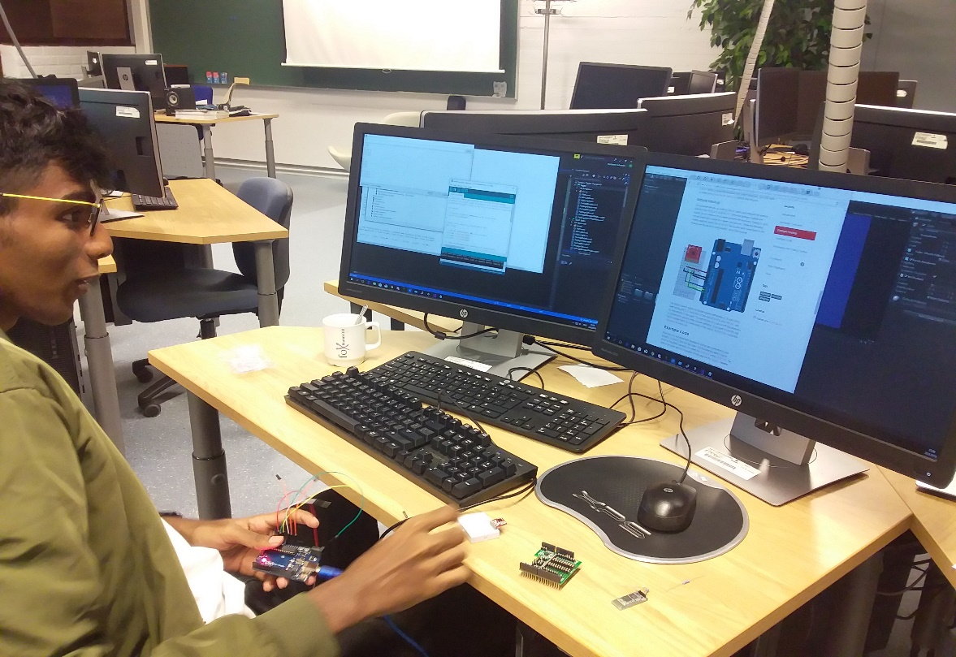
Sound Surfer uses an Arduino as a proof of concept for a smartwatch controller.
- Arduino Accelerometer
Gathering data
Interpreting data
Feeding data into unity
Generating game play from data

Slide 5
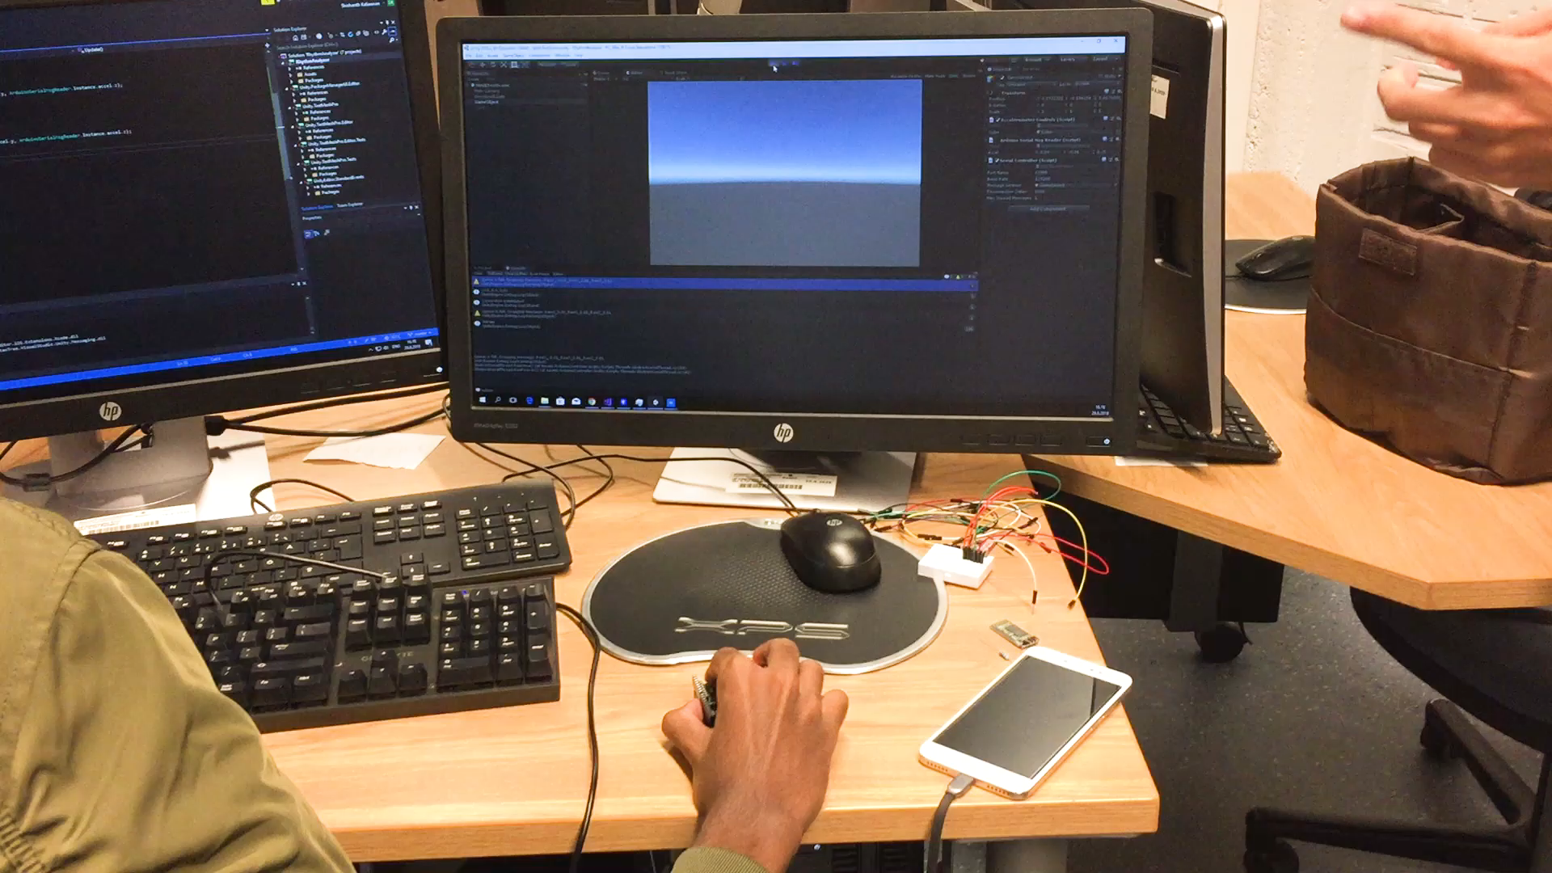

Slide 6
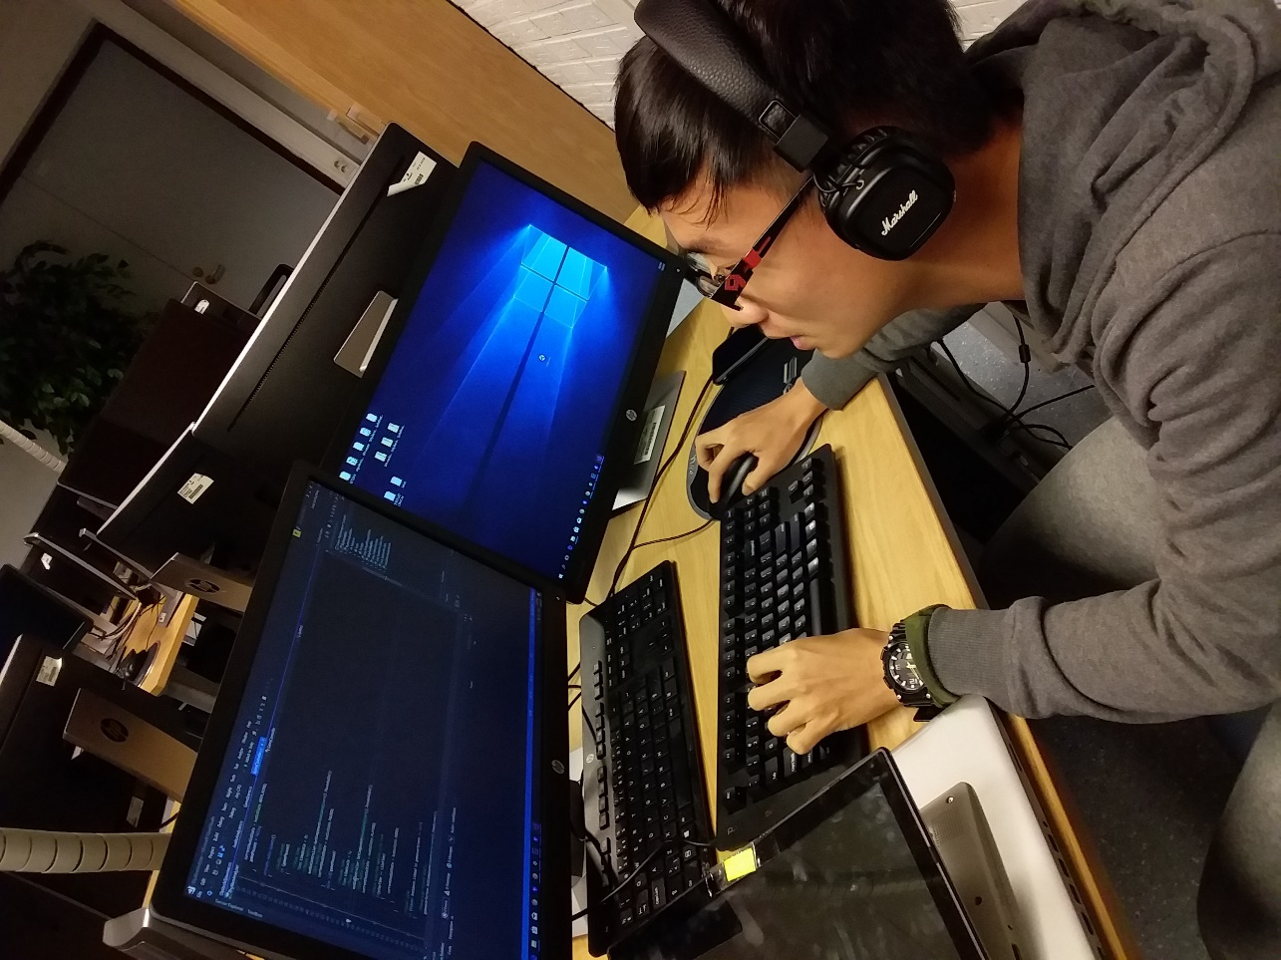
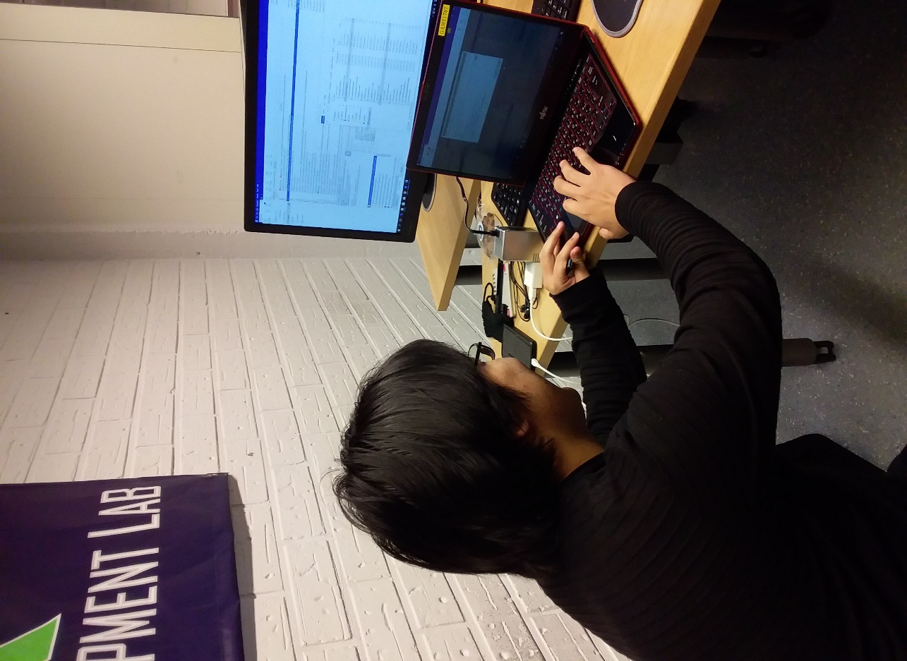
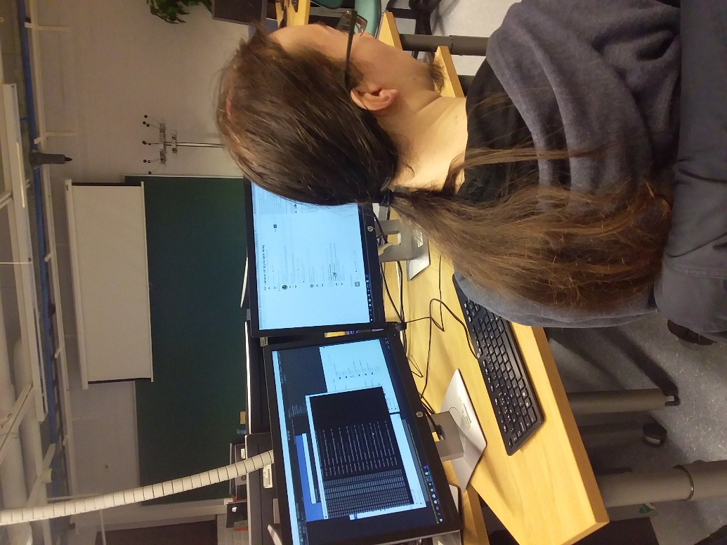
Coding
Generating the Sound Wave
Sound responsiveness
Spawning enemies from the beat
Interpreting sound waves
Data Compression
Bluetooth ( experiments)

Slide 7
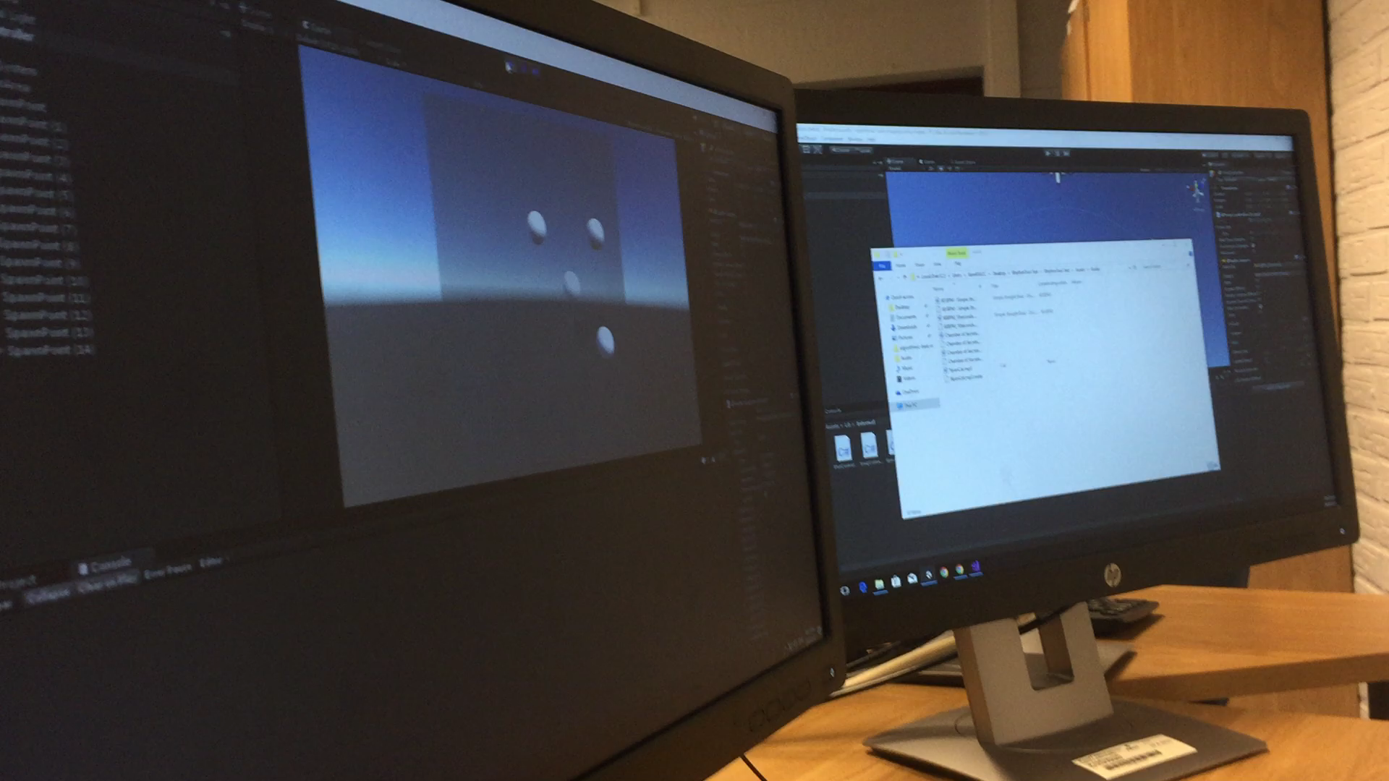

Slide 8


Slide 9


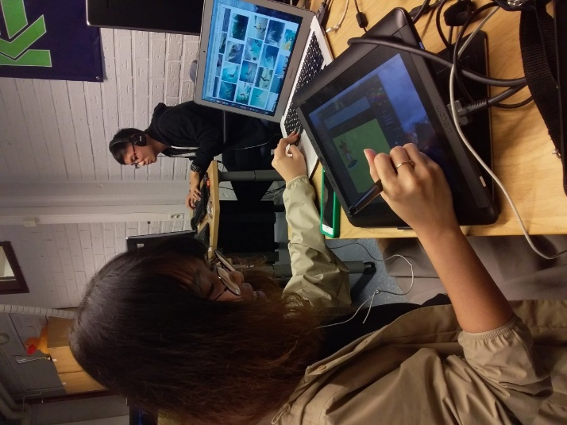

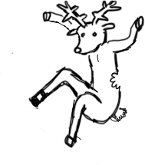

Sprite Design and Animation

Slide 10



Surfing The Web
Ethernet Seaweed
Seagull
Killer Cursor Shark

Slide 11
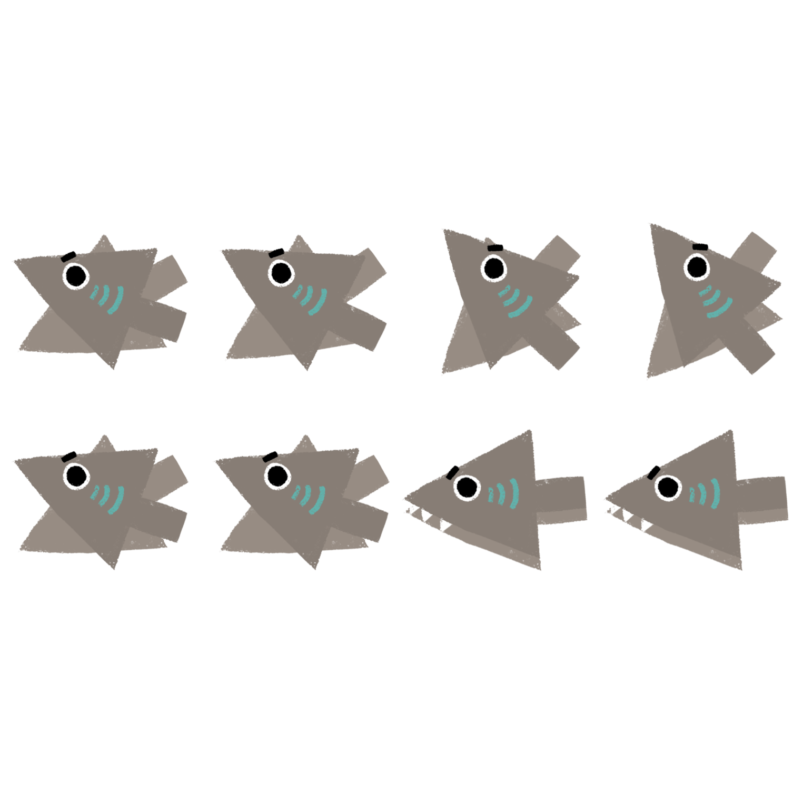

Slide 12


Slide 13
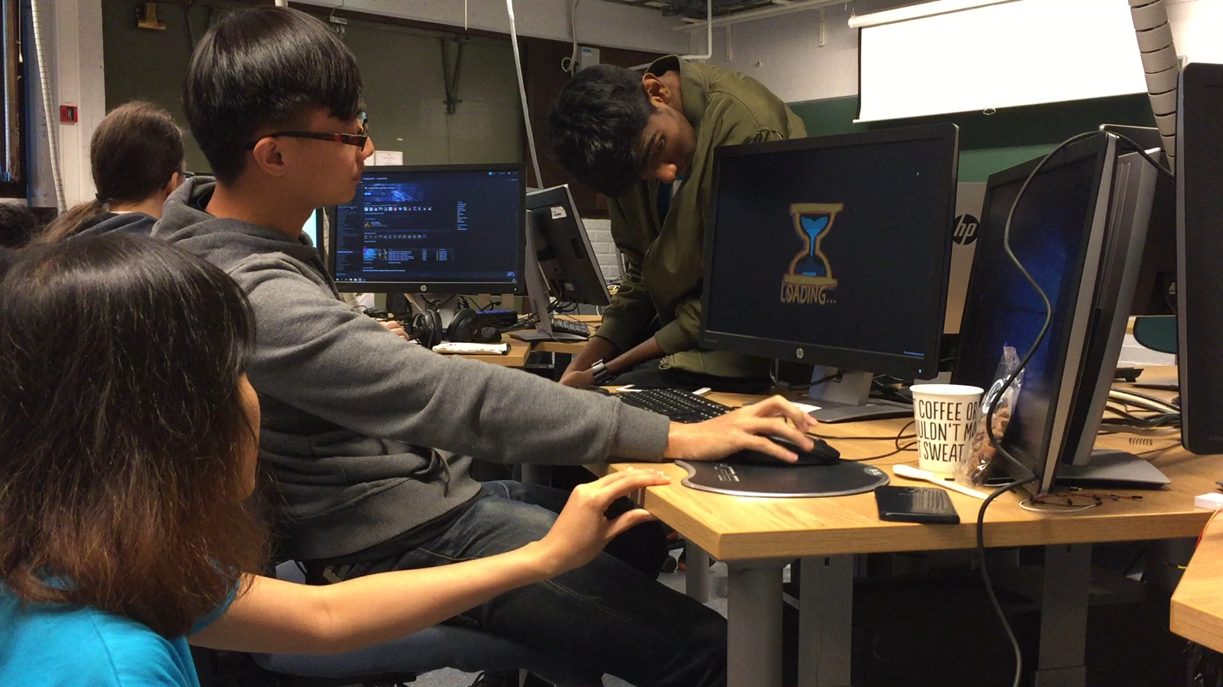


We would love to know what you think of Sound Surfer.
We are seeking feedback to help us design the next iteration of our game.

